Slide 1

REDUCE – REUSE - RECYCLE
Sarika Bommavaram (08)
Gouri Priya Vangavargu (50)
Sasidhar Malladi (32)
Sankalp Racharla (43)

Slide 2
Contents
Introduction
Services Implemented
Services Used
Sequence Diagram for Services
Screenshots

Slide 3
Introduction
This application answers all the questions about waste management in Kansas City.
We developed native android application.
One has to plan time and date to get all the waste together.
We can also get reminders before the specified deadline of collection.
Provides rich and user friendly UI.

Slide 4
Services Implemented
GET /validate/{username}/{password} to validate the registered user
GIVEAWAY/register which requires json data in the following format to store the user details in database.
{
Name:”char”
Image:”Blob”
ItemCost:”Int”
Category:”char”
Phone:”int”
}
RECYCLE/Schedule which requires json data in the following format to store the user details in database.
{
Name:”Char”
Street Address:”Name”
Apt:”Int”
No of bags:”int”
Phone number:”Int”
}

Slide 5
Services Used
White Pages API to get the Nearest Recycling Centres Location
https://proapi.whitepages.com/2.1/business.json?api_key=358ffc0ef5c4916d45f5f0c9edf61469&postal_code=" + 64110+ "&name=Recycling+Centers
Google Maps API to retrieve the nearest stores.
https://maps.googleapis.com/maps/api/place/textsearch

Slide 6
UML Activity Diagram

Slide 7
SYSTEM ARCHITECTURE

Slide 8
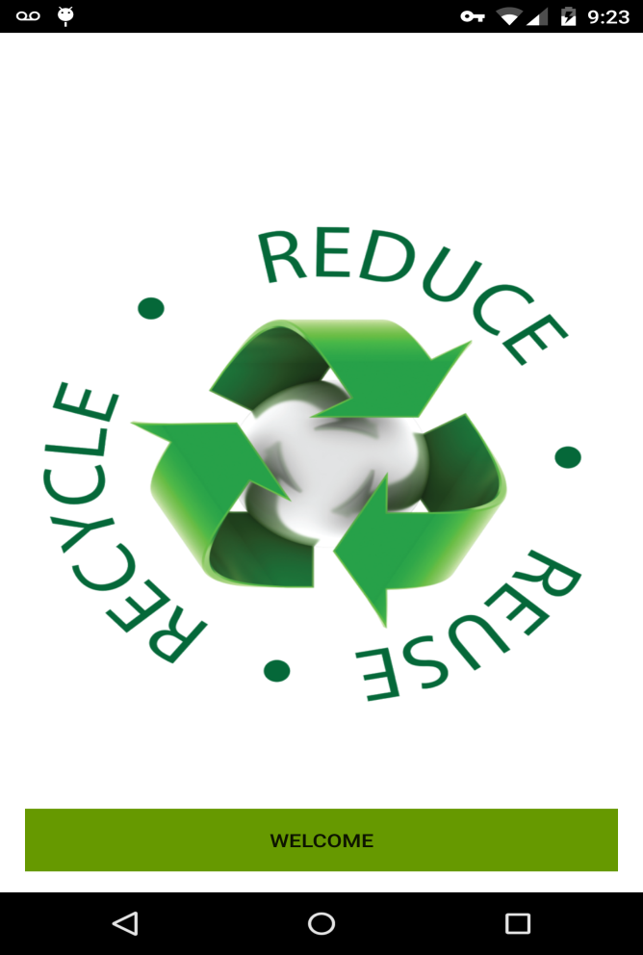
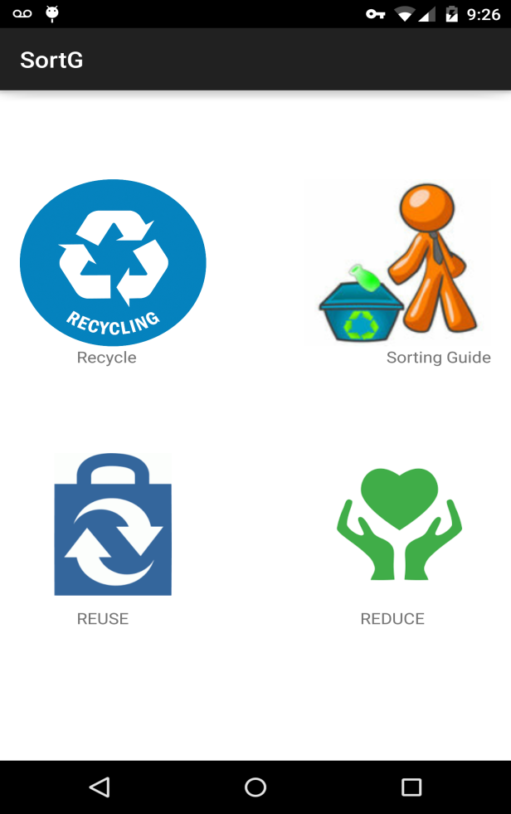
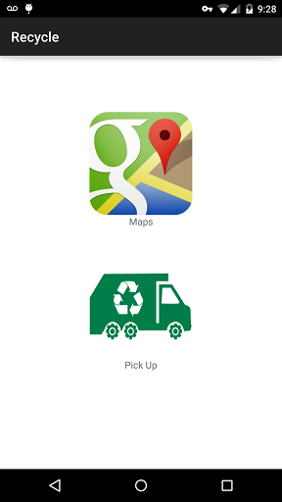
SCREEN SHOTS

Slide 9
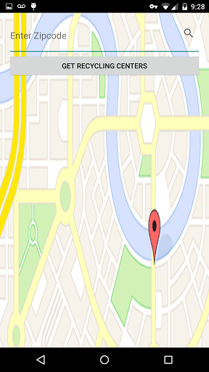
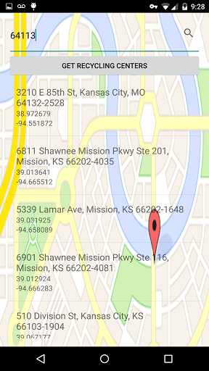
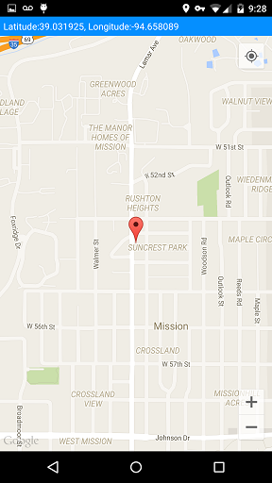
SCREEN SHOTS

Slide 10
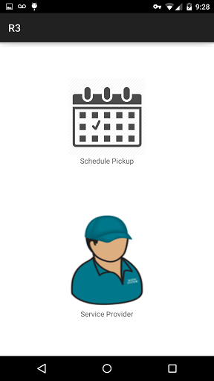
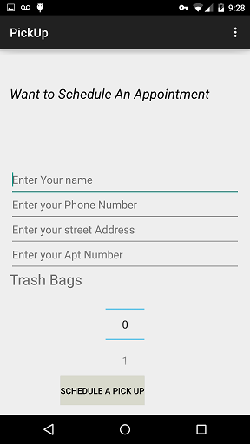
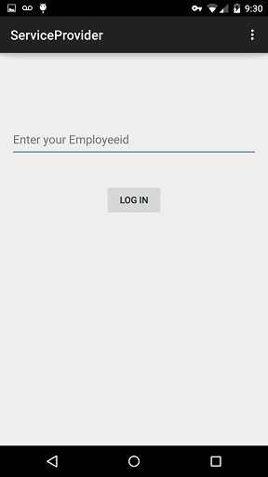
SCREEN SHOTS

Slide 11
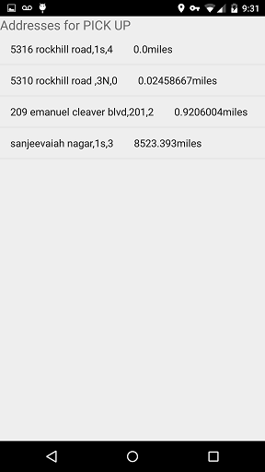
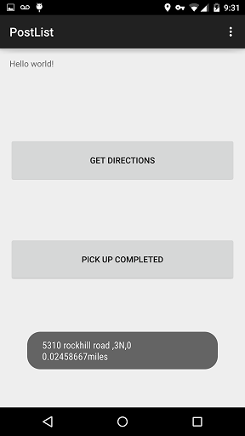
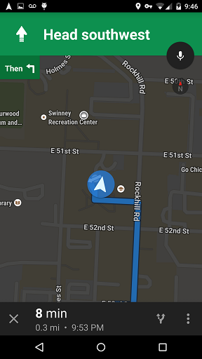
SCREEN SHOTS

Slide 12
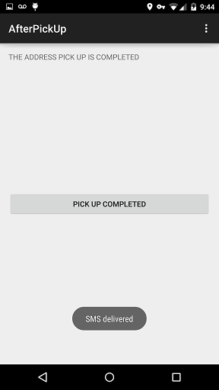
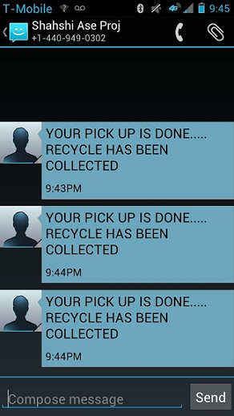
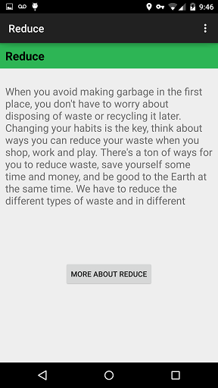
SCREEN SHOTS

Slide 13
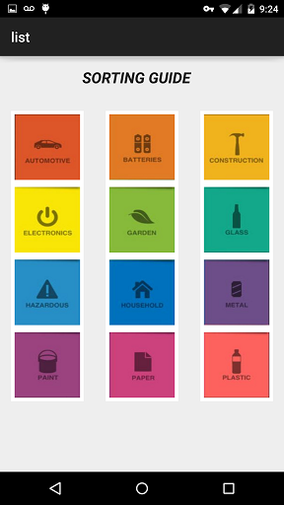
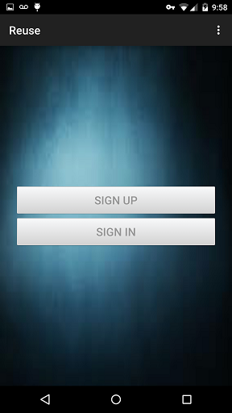
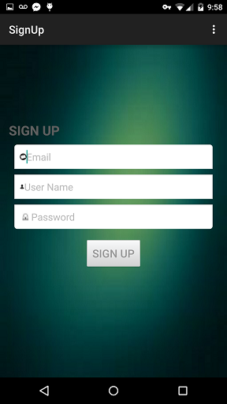
SCREEN SHOTS

Slide 14
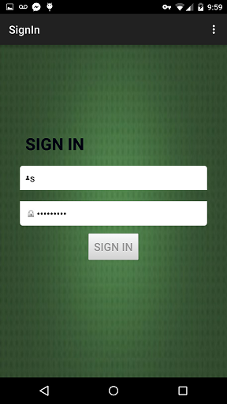
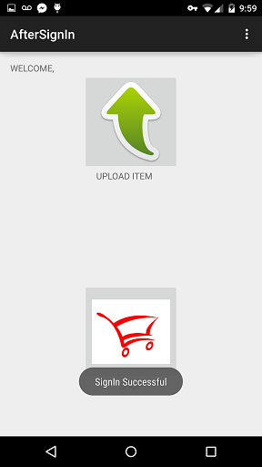
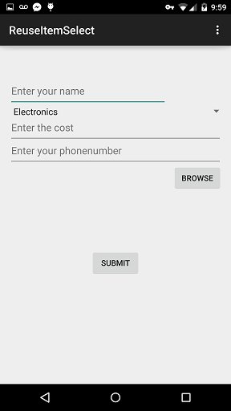
SCREEN SHOTS

Slide 15
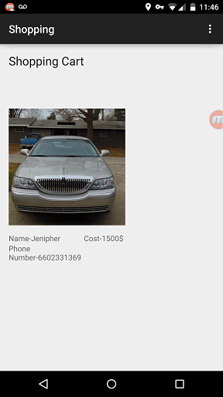
SCREEN SHOTS

Slide 16
Thank You

